Slide 1
INFO 5100 Final Project Keyboard Man
Xuyang Li 001409590
Jiaao Yu 001464004

Slide 2
Content
Problem Statement.
Developing Approaches.
Object Model.
Use cases & functionalities.
Others:
Screenshots.

Slide 3
Problem Statement
Soccer League Management System
University Soccer League
Proposed Entities:
Soccer Association, Matches, Referees
Club1, Club2, …
Club Managers, Coaches, Players

Slide 4
Developing Approaches
Problem Definition – What are we going to do?
Design - business model design, user cases
Specification - user interfaces design
Implementation – code the system

Slide 5
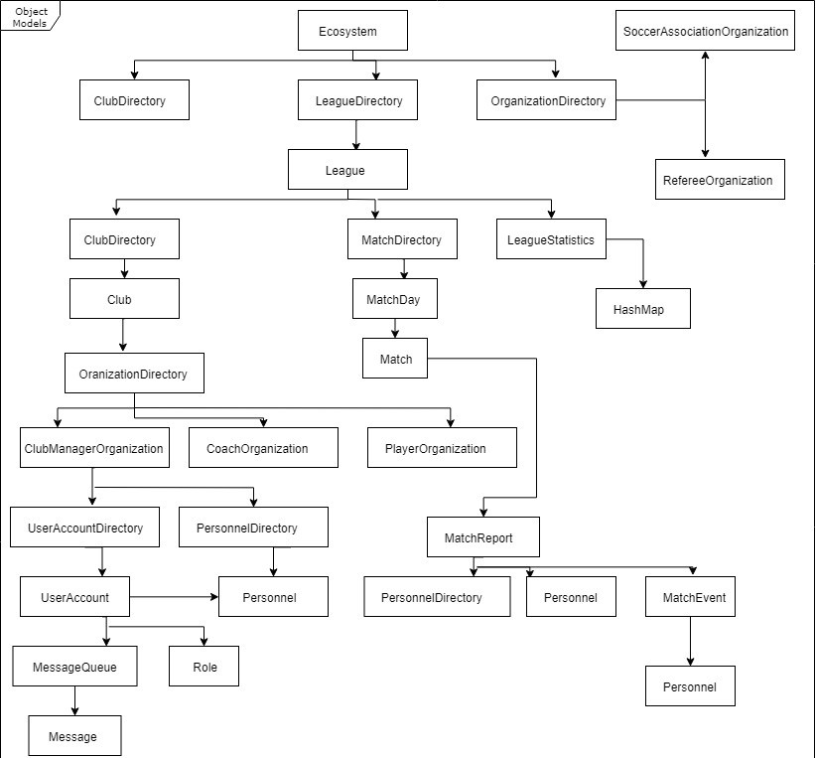
Object Model

Slide 6
Use cases & functionalities
Soccer Association:
Manage Leagues in different types
Manage matches (creating, updating schedules of a match, handle complex match calendars)
Manage referees
Assign a referee to a match
Manage clubs (create a default club manager)
Manage user accounts and passwords
Send message to clubs, coaches and players

Slide 7
Referee :
Record result of a match (score, substitution info, etc)
Record booking info of a match (giving disciplines to a player)
Club Manager :
Manage players (transferring players between clubs)
Manage managers & coaches
Create new teams and promoting or demoting a player to higher or lower team,
Manage squad list of a match
Send information to coaches and players

Slide 8
Coach:
Manage a match (decide line-up, decide captain, decide formation)
View players performance
Send message to players
Player:
View statistics and performance
Send messages

Slide 9
Additional Features:
The followings will be visible to all the people using this system:
Rank of teams
Result of each game
The top strikers and top assisting players in the league
SA is able to send message to anyone using the system while others can only send message to people under same club.
A match simulator may be added to the system one day in order to better explain the whole system.

Slide 10
System Core Function- Match Process
Process:
Soccer association creates matches
Soccer association assigns a referee to match
Club managers of both teams provide squad list of match
Coaches of both teams provide match list of the match, from the squad list
Referee provides the match report, match is over.

Slide 11
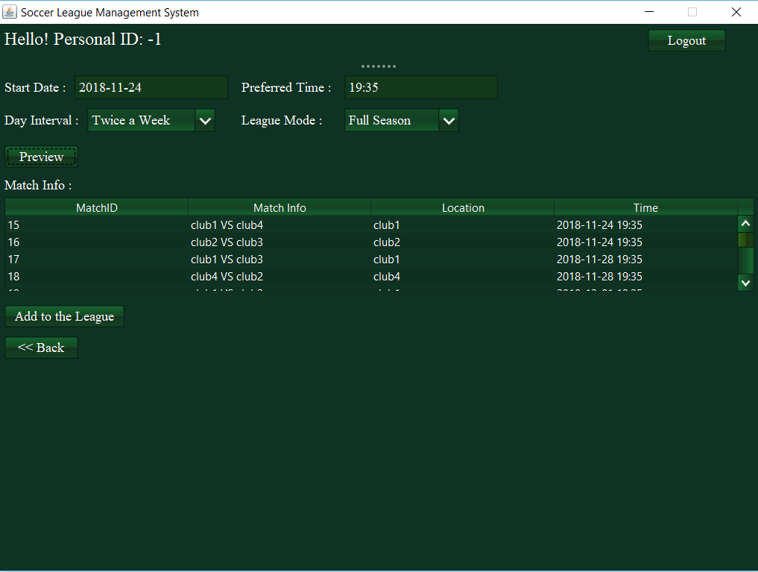
Screenshots-Create Matches

Slide 12
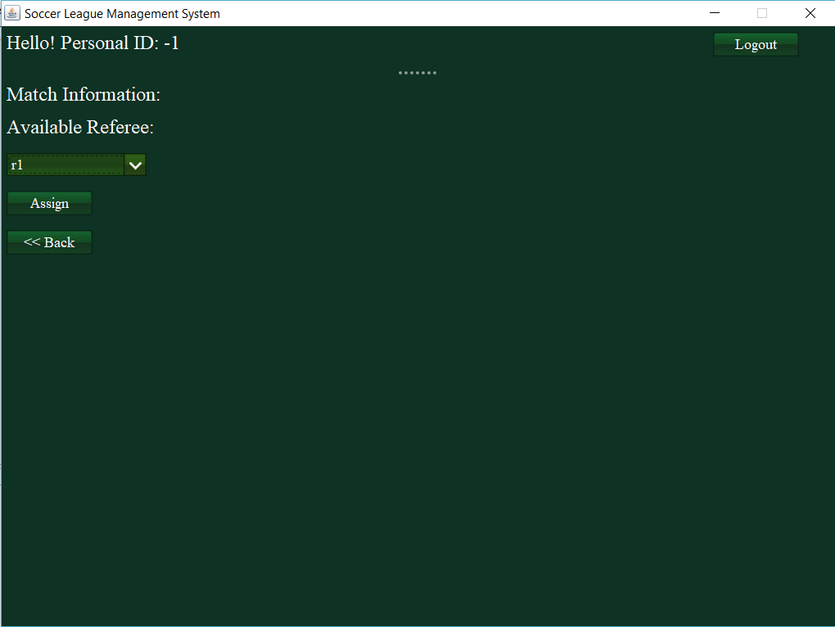
Screenshots-Assign Referee to Match

Slide 13
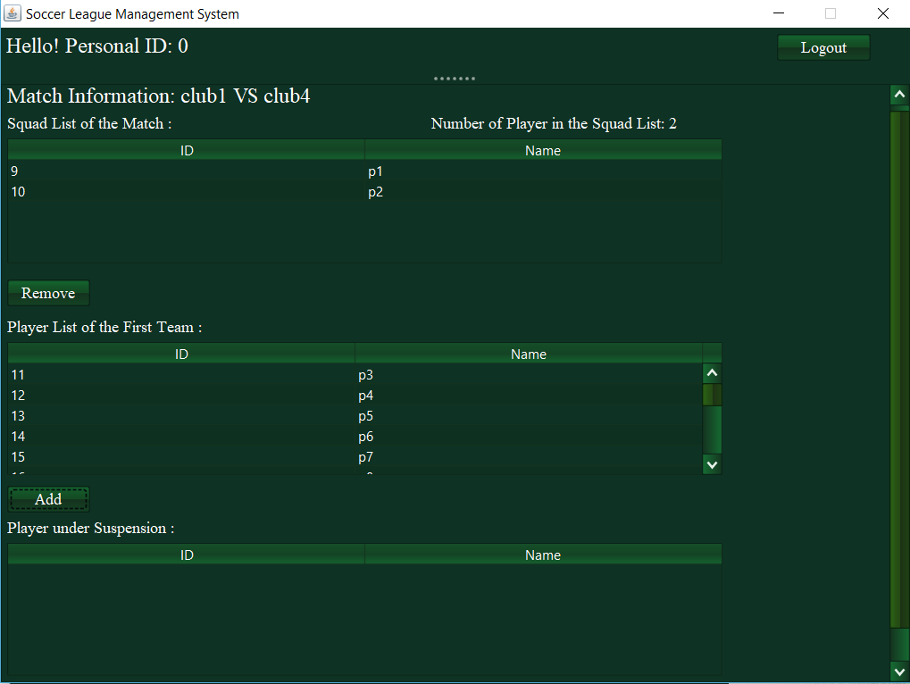
Screenshots-Provide Squad List

Slide 14
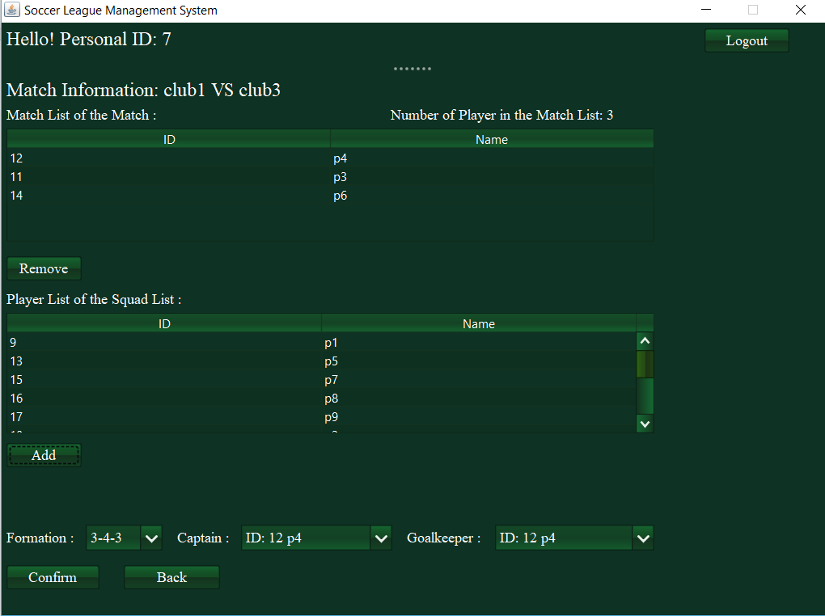
Screenshots-Provide Match List

Slide 15
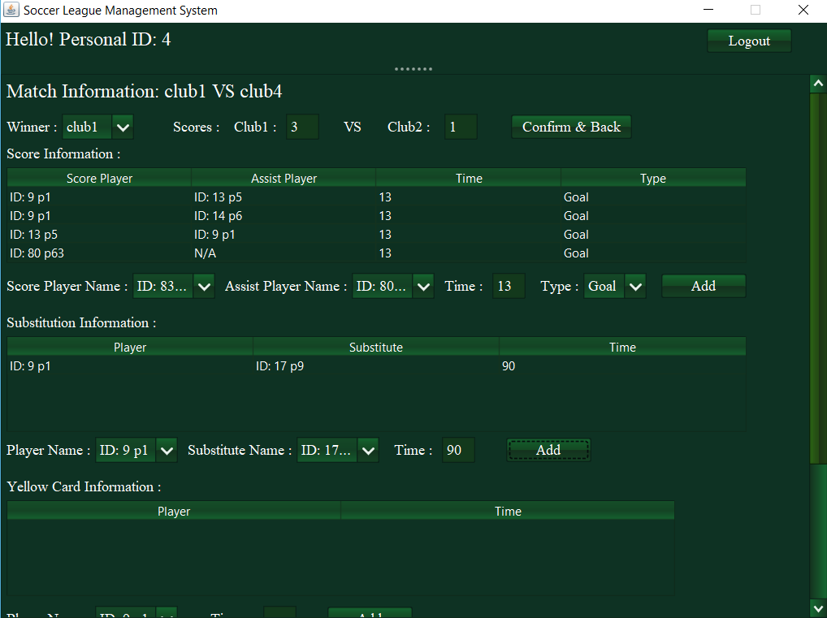
Screenshots-Provide Match Report

Slide 16
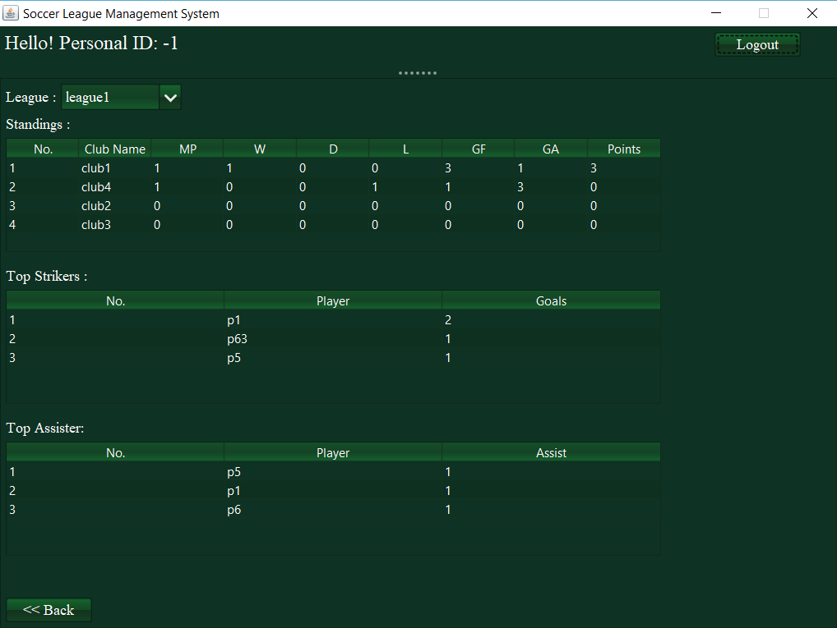
Screenshots-Match Over, View Performance

Slide 17
System Other Function-Communication
Rules:
SA is able to send message to anyone under the system
Club Manager can only send message to persons under same club or the club manager of other clubs or SA
Coaches and players can only send message to persons under the same club or SA
Referee can only send message to SA.

Slide 18
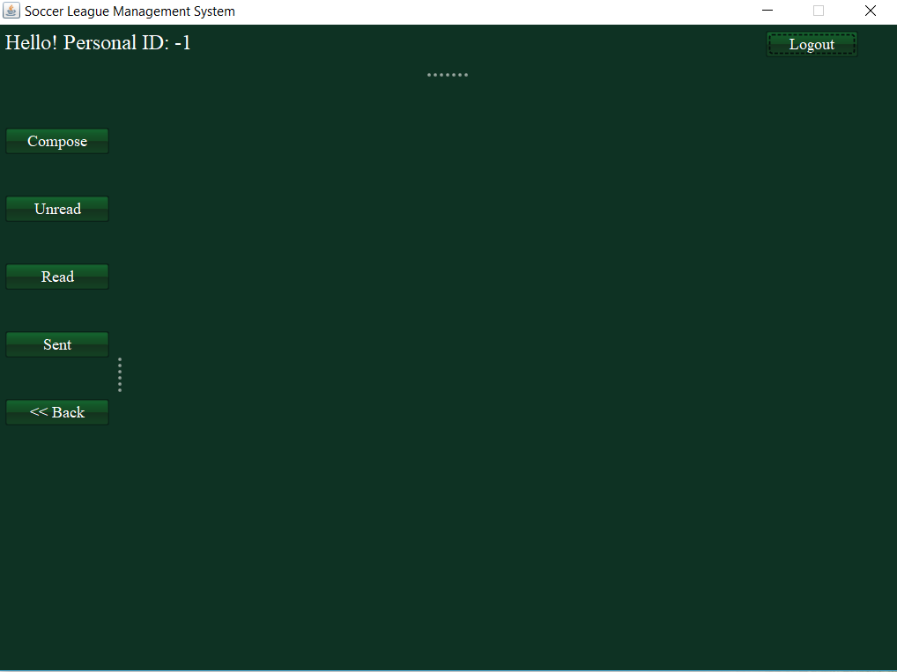
Screenshots-Send Message

Slide 19
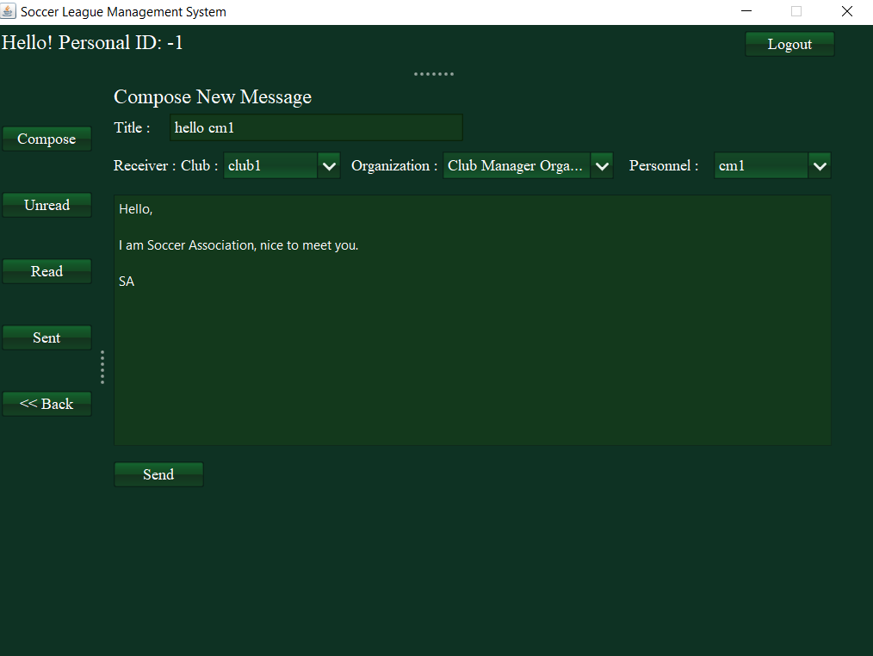
Screenshots-Send Message

Slide 20
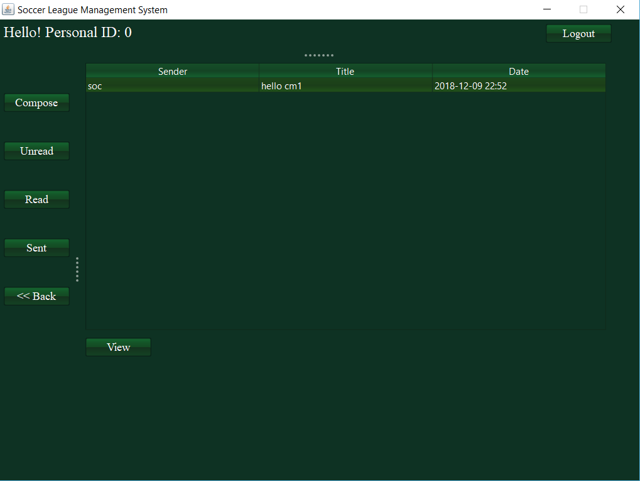
Screenshots-Send Message

Slide 21
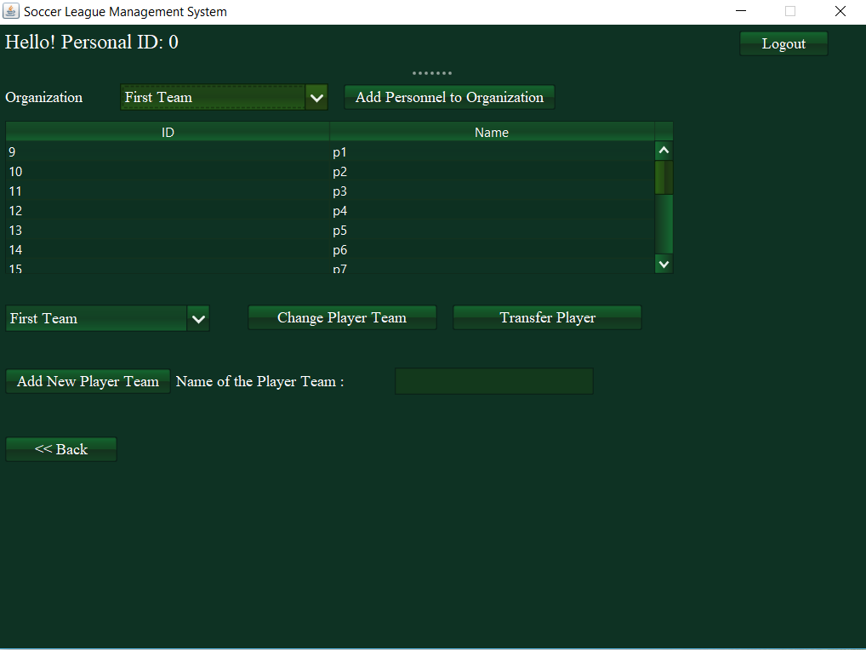
System Other Function- Manager Personnel of Club

Slide 22
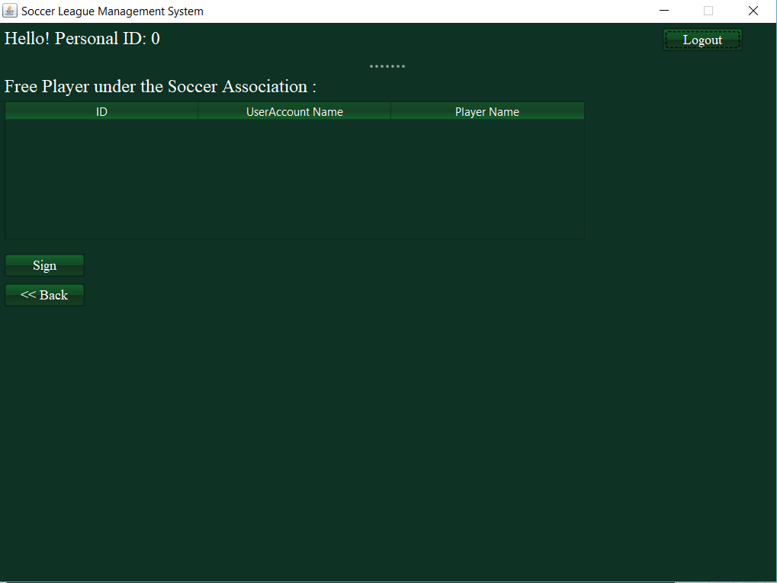
System Other Function- Transfer Players

Slide 23
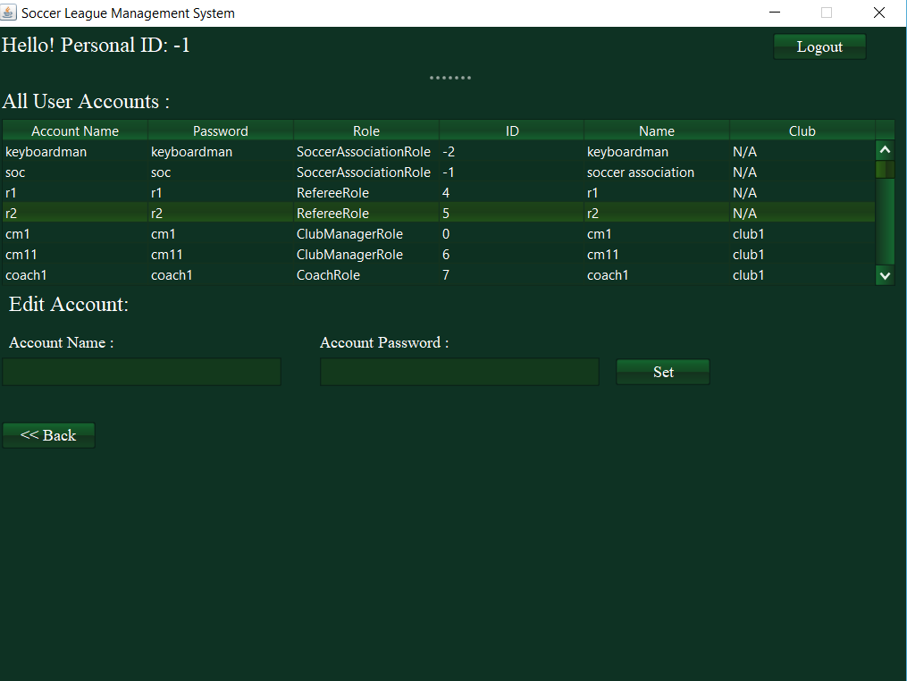
System Other Function-Manage Account

Slide 24
Time for the Demo!

Slide 25
Thanks!
Q & A

